Slide 1





Supporting breastfeeding here, there and everywhere
Click the symbol here
and at the top of each
page for audio

Slide 2
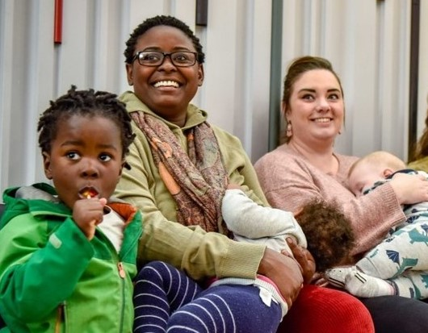
Why a Breastfeeding Friendly scheme?
Breastfeeding benefits mums and babies. The UK has very low breastfeeding rates, we want to change that in our area
Although breastfeeding anywhere is protected in UK law, many mums still
feel anxious about breastfeeding whilst
out and about, so use formula feed instead
To help protect, promote, support and normalise breastfeeding as part of our Bradford District Breastfeeding Strategy

Slide 3
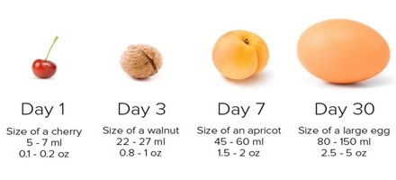
Babies can’t wait when they’re hungry…
Babies tummies are tiny, they need to feed often and can’t wait until they get home
Breast milk supports life-long health outcomes and provides a warm, tasty
drink and meal all together
Babies also enjoy a snuggle with mum
If mothers feel relaxed they find it
easier to breastfeed –
happy, relaxed mum, happy well-fed baby!
Approximate size of a baby’s stomach

Slide 4
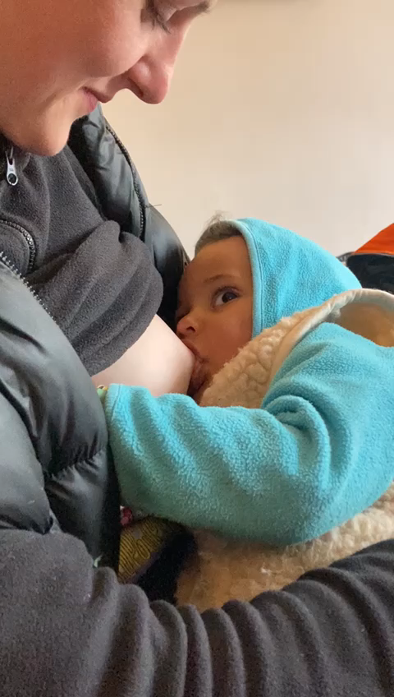
What is the Breastfeeding Friendly scheme?
Open to any public venue, organisation, education establishment, transport company, restaurant or food venue across the district
Demonstrates your support for breastfeeding mothers
Indicates that you offer a welcoming space where mothers can feel comfortable breastfeeding their babies wherever they need and wish

Slide 5
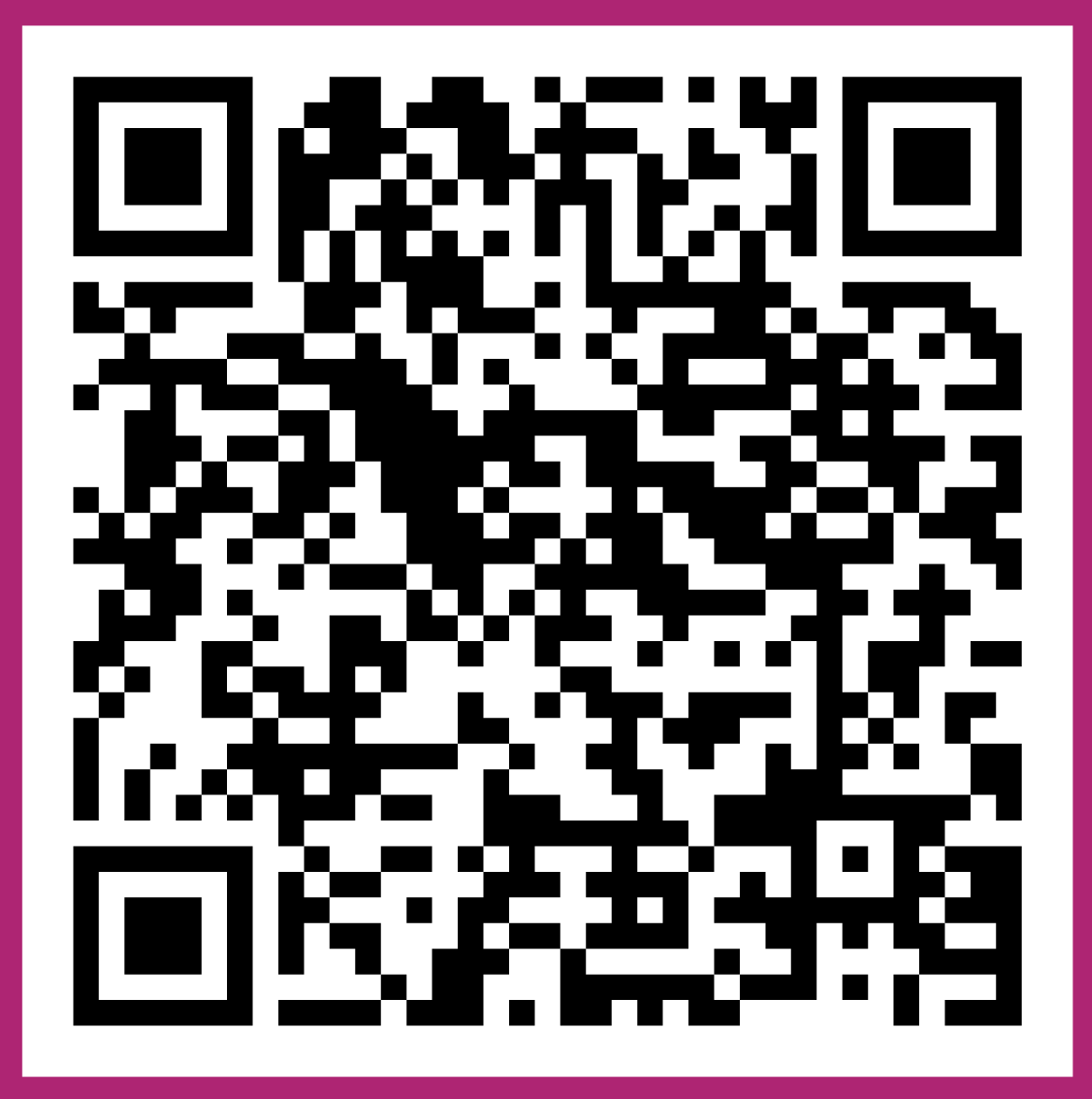
How do I join?
Scan me to view the Breastfeeding Friendly checklist
It couldn't be simpler - just confirm you can say 'yes' to the Breastfeeding Friendly checklist on our website, then fill in the registration form
No training is required - all we ask is that you have friendly staff, ready with a smile and willing to give thought to the comfort and welcome families receive in your venue

Slide 6

What do I do when I’ve joined?
Ensure all staff are aware of how to implement our breastfeeding policy
Display the Breastfeeding Friendly certificate and stickers
Welcome women who wish to breastfeed, alongside all women and families

Slide 7

What happens if there’s a problem?
Discuss as a team in advance how you will manage the situation if a member of the public makes a negative comment about a baby being breastfed.
If this occurs, explain to the complainant that you support breastfeeding as it is important for babies to have their mother’s milk where possible. If they are not happy then they can leave.
Support each other if this situation occurs and seek support from your manager.

Slide 8
Email us at: breastfeedingfriendly@bdct.nhs.uk
Find us on Facebook and Instagram at: communityinfantfeedingBDCFT

