Slide 1
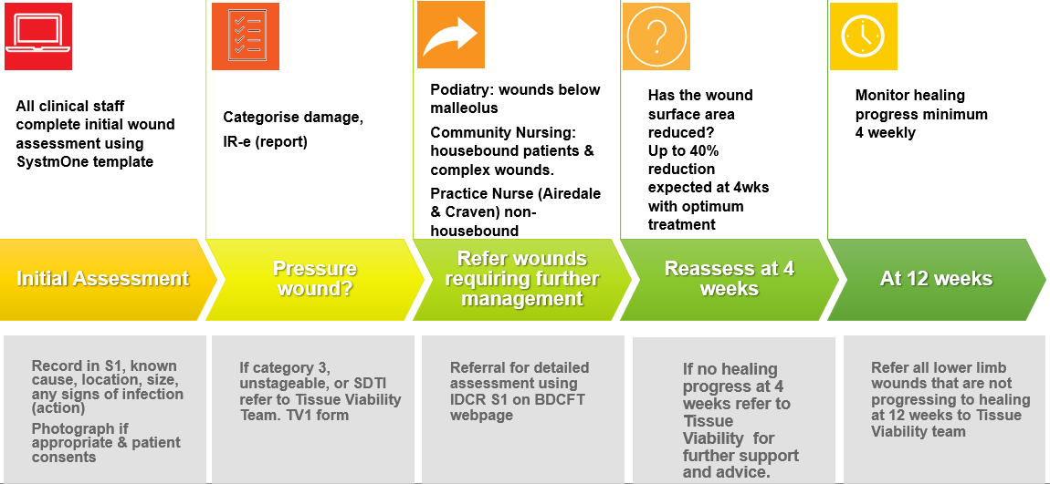
July 2023
Pocket Guide to Management of Wounds Identified By Staff

