Slide 1
Categorisation and Reporting Guidance Darker skin tones

Slide 2
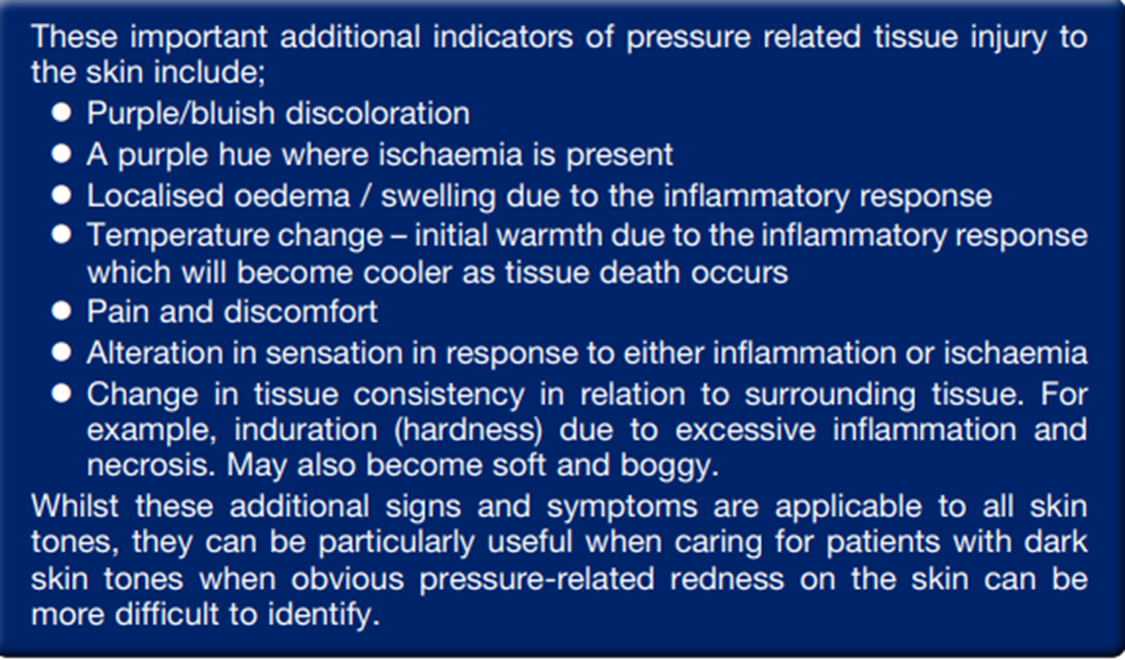
Darker skin tones can mask the visual indicator of erythema and category 1 pressure ulcers. To reduce the risk of these developing into full thickness pressure ulcers in patients with darker skin tones, it is essential to recognise the other signs and symptoms that can be observed

Slide 3
Category 1
Category 1 pressure ulcer – Non blanchable erythema
Intact skin with non-blanchable redness of a localized area, usually over a bony
prominence. Darkly pigmented skin may not have visible blanching but its colour may differ from the surrounding area. The area may be painful, firm, soft, warmer or cooler compared to adjacent skin. Often difficult to detect in darkly pigmented skin tone
MAY INDICATE AT RISK PATIENTS – IR-e NOT required
TV referral if patient non-concordance identified, to refer
to non-concordance pathway and flowchart and complete
mental capacity assessment

Slide 4
Category 2
Category 2 pressure ulcer – Partial thickness skin loss
Partial thickness loss of dermis presenting as a shallow ulcer with a red/pink wound
bed, without slough. May also present as an intact or open/ruptured serum-filled
blister. Presents as a shiny or dry shallow ulcer without slough or bruising
(Bruising indicates SDTI)
IR-e required – to re report if deterioration to category 3
TV referral if patient non-concordance identified, and refer
to non-concordance pathway and flowchart and complete
mental capacity assessment

Slide 5
Category 3
Category 3 pressure ulcer – Full thickness skin loss
Subcutaneous fat may be visible, but bone, tendon, or muscle will not be exposed.
Slough may be present but does not obscure depth of tissue loss and may include
undermining or tunnelling. The depth of a category 3 pressure ulcer will vary with
location on the body
IR-e required – to re report only if deterioration to category 4
TV referral
If patient non concordant, refer to non-concordance
pathway and flowchart and complete mental capacity
assessment

Slide 6
Category 4
Category 4 pressure ulcer – Full thickness tissue loss with exposed bone, muscle or tendon
Full thickness tissue loss with exposed bone, tendon, or muscle. Slough or eschar
may be present on some parts of the wound bed. Often includes undermining or
tunnelling. The depth of a category 4 pressure ulcer can vary dependent on location and can extend into muscle and/or underlying structures (eg fascia, tendon or joint capsule) making osteomyelitis possible. Exposed bone/tendon is visible or directly palpable
IR-e required
TVN Referral
Refer to non-concordance pathway and flowchart and
complete mental capacity assessment if identified patient
non-concordance

Slide 7
Unstageable
Unstageable pressure ulcer - depth unknown
Full thickness tissue loss in which the base of the ulcer is covered by slough
(Yellow, tan, grey, green or brown) and/or eschar (tan, brown or black). Until enough slough and/or eschar is removed to expose the base of the wound, the true depth and category cannot be determined
IR-e required – to re report only if deterioration to category 4
TV referral
Refer to non-concordance pathway and flowchart and
complete mental capacity assessment if identified patient
non-concordance

Slide 8
SDTI
Suspected deep tissue injury - depth unknown
Purple or maroon localized area of discolored intact skin or blood-filled blister due
to damage of underlying soft tissue from pressure and/or shear. Evolution may
include a thin blister over a dark wound bed. The wound may further evolve and
become covered by thin eschar. Evolution may be rapid, exposing additional layers
of tissue even with optimal treatment. Deep tissue injuries may be difficult to detect in individuals with darker skin tones, the area may be preceded by tissue that is painful, firm, mushy, boggy, warm or cooler compared with adjacent tissue.
IR-e required – to re report only if deterioration to category 4
TV referral
Refer to non-concordance pathway and flowchart and
complete mental capacity assessment if identified patient
non-concordance

Slide 9
MASD
Moisture associated skin damage – This can occur due to the presence of any type
of moisture on the skin, including incontinence, leakage from a stoma, saliva, wound
exudate and sweat. Multiple lesions with diverse edges are typical of incontinence
associated dermatitis
THIS CAN INCREASE THE RISK OF PRESSURE DAMAGE
IR-e required when acquired in BDCFT only
To re report only if deterioration to category 2 and above pressure damage
TVN Referral for all non-concordance and refer to
non-concordance pathway and flowchart and complete
mental capacity assessment

